Slide 1


Notes:
Good morning and welcome to the developing an advocacy plan webinar. My name is Heather Lockard and I am the training and development manager for the Missouri association for community action or MACA. Today we are going to focus on the nine steps to think about when advocating. These nine steps will be used to create a plan to help you be intentional about the advocacy work that you do. Although this webinar will focus primarily on the advocacy work you do with legislators and Missouri congressional members it could be used for any advocacy work that you do.
Before we get started, I would like to ask everyone to mute their phones. If you do have to step away during the webinar we completely understand but please do not put your phone on hold or we all get to listen to your music. We will have time for question and answer at the end.

Slide 2


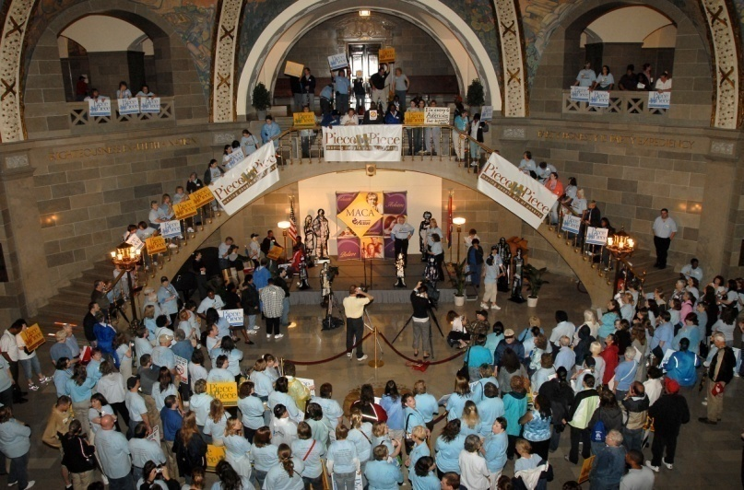
Developing an Advocacy Plan
Putting it to Work
Notes:
Why should we develop an advocacy plan? We are all knowledgeable about Community Action and poverty and are passionate about the work that we do. However, sometimes passion alone is not enough. Advocacy involves getting powerful individuals or organizations to make big changes that may not be in their short-term interest. Often involves working in the public eye and involves sticking out your neck, as you take a stand against a larger opponent. Planning will help you find out ahead of time where the major difficulties may lie, and to avoid surprises. In addition, as with any project, planning will help you to:
Clarify your goals, the steps that will take you to your goals, and increase your chances of success.
If you don't plan, you may waste valuable energy, miss some opportunities, perhaps even antagonize people you need to keep on your side.
So when should you create a plan for advocacy?
It's important to complete a plan before you start advocating, because, as you will find, each part of the plan can affect the others.
Normally, planning your goals comes first--but you may have to change those plans if you find, as you plan further, that the tactics you were hoping to use won't work. When you plan everything together you can both build support and make adjustments as you go.
Planning is best done as a group activity. One way is to write up ideas on a whiteboard or on butcher paper. Then, after they've been debated, record the ideas you've chosen in a permanent place. The actual format of the plan is not important. What's important is that you write it down in a form you can use, and that lets you check one part of the plan against the rest.

Slide 3

The Missouri Association for Community Action
Types of Advocacy
Self
Case
Cause
System
Notes:
What is advocacy? There are four types of advocacy, or the broad category names for the types of advocacy people do. The first is:
Self-advocacy: The act of pleading or making a case for change or assistance that affects primarily you, but that may in the process of helping you actually affect others. Examples might include: writing a letter to a credit card company asking them to lower your interest rate; going to a school board meeting to ask them to create an allergy policy that will keep you and your kids safe from peanuts; appealing a property tax assessment.
The second type is Case-advocacy: it involves utilizing the court system to make a legal argument that results in relief of a problem for an individual or group and often, by their nature, create a change in legal, governmental and/or societal structures and standards. Examples might include: Roe v. Wade; Brown v. the Board of Education;
The third type of advocacy is Cause-advocacy: it involves being educated about and educating others about an issue or problem that requires change in order for the problem to be reduced or solved. Often, groups of like-opinioned people will organize themselves in order to create a stronger voice for the change or implementation of the change they would like to see happen. The cause often becomes synonymous with the advocacy group associated with it (i.e., drunk driving and MADD). Cause-advocacy’s primary appeal is to the population at large. Examples might include: environmentalism; pro-life; drunk driving reduction; recycling;
The final type of advocacy is Systems-advocacy: While similar to cause-advocacy and usually occurring simultaneous to a cause, systems-advocacy is differentiated by its appeal being made to “the system” or “system representatives.” Thus, system advocacy is done when the problem-solving change will or needs to occur within the context of laws, policies, and procedures already in place or that require entire systems to put something in place. Examples might include: health care reform; welfare reform;

Slide 4
The Missouri Association for Community Action
With Whom do We Advocate?
How We Advocate?
Media
Business Owners
Legislators & MO Congressional Members
Community Members & Leaders
Family
Education (Public, Policy and Voter)
Organizing and Mobilizing
Research
Partnerships
Events
Notes:
Typically, when you talk about advocacy, people assume that you are advocating with legislators, but we advocate with many different types of people. People in our own field, the media, community members, family members and legislators. Like I said earlier, although this webinar will focus primarily on your work with legislators and MO congressional members this plan can be useful in any advocacy work that you do.
Just like we advocate with many different types of people we also advocate in many different ways. We advocate through education, whether it be public education or educating our constituents about an issue. We testify and educate policy makers about specific policies. We also may participate in non-partisan voter education and community mobilization.
CAAs are also very engaged in organizing and mobilizing the community on behalf of low-income families. It is one of the primary reasons that community action agencies were created.
We also research and disseminate information, create partnerships and advocacy events. For example, about a year ago, over 200 members of the Missouri CAA network participated in advocacy day. Members of the network marched to the capitol and met with legislators to inform them about he realities of poverty in their districts and advocated on behalf of low income people.
I would like to hear from you. How have you advocated? Launch Poll…

Slide 5
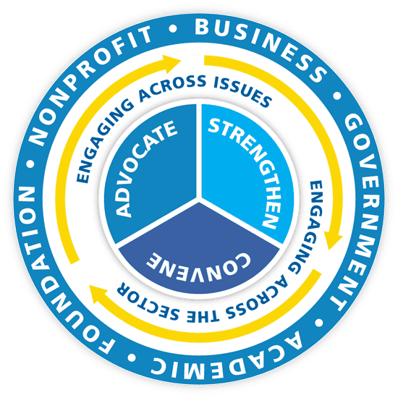
The Missouri Association for Community Action
Effective Advocacy
Legitimate
Credible
Transparent
Accountable
Understand the relationship between advocacy, power and politics
Notes:
Be honest, if a legislator asks you a question and you do not know that is ok. You do not have to know everything! However, tell them that you can find out the answer for them and follow up!! If you say you are going to do something you need to do it.

Slide 6

Statewide Vision
United in purpose,
the Missouri
Community Action Network
will inspire and engage people
to ensure that all
families and communities thrive.
Notes:
6
Why do we advocate? To meet the statewide vision of the Missouri community action network…

Slide 7
The Missouri Community Action Network
Notes:
7
You are not alone, there are 18 other agencies and 3,000 community action staff just like you advocating for low income families and change. Think about the power of this network and the changes that we can create! However, to be effective, you do want to be organized. That is what this webinar is about today, to offer you a nine step plan to help you organize your advocacy work.

Slide 8
Identify & Define your Issue
Research the Issue
Develop a Strategy
Establish a Plan of Action
Prioritize your Goals
Build your Base of Support
Get to Know people and Key Players
Know the Process
Monitor Legislative Activity of the Issue
Developing an Advocacy Plan
Notes:
The nine steps of the advocacy plan are
Identify and define your issue
Prioritize your goals
Research the issue
Develop a strategy
Establish a plan of action
Build your base of support
Get to know people and key players
Know the process
Monitor legislative activity

Slide 9
Identify and Define your Issue
1
Notes:
An advocacy plan will serve as a guide for your action. Developing a plan will help ensure that you have considered all important aspects of your plan and have made the decisions necessary to begin your action. There is nothing magical about the plan -- it is simply a problem solving tool -- but a very helpful one since you can use it as a road map to guide you through the rest of the advocacy process. In developing your plan you will describe your starting point, your destination, and what you will do to reach your destination.
The first step in developing your advocacy plan is to identify and define your issue. Write out a short statement of the problem, writing a statement of the problem in your plan will help you focus your thinking and it will be a helpful reminder if you get stuck or sidetracked. Is your issue poverty, homelessness, job creation, etc.

Slide 10
Prioritize your Goals
2
Notes:
After you have identified your issue you will prioritize your goals. You can start by asking yourself “What needs to change in order to affect the issue?”
Your may also want to brainstorm any norms, policies, procedures and/or laws that need to change in order to affect your issue.

Slide 11
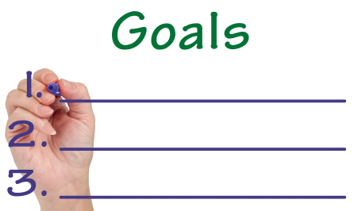
Prioritize your Goals
Determine Goals:
  Long
  Intermediate
  Short
The Missouri Association for Community Action
Notes:
If you are asked what the goal of your advocacy plan is, your answer may come out in the form of a mission statement: "Our aim is to create decent and affordable housing," or "We intend to reduce pollution of the local waterways." However, for planning purposes, goals should be split down into much more specific steps Remember that it's better to keep your focus on a relatively narrow, manageable group of issues, rather than letting yourselves try to cover too much ground, and lose strength in the process. It's also important to split up the goals according to your time-frame, so you may have long-term, intermediate and short term goals.
Your long term goals will spell out where you want to be at the end of the advocacy plan
Your intermediate goals get you much of the way. They focus on community and systems changes and provide concrete building blocks towards the ultimate goal.
Your short term goals have some of the same functions as the intermediate goals. They keep you and/or the group motivated and provide more immediate benchmarks in the form of action steps.
Once you have completed your brainstorming look over the entire list and determine what you would most like to achieve. Be realistic about the options that are available to you but do not limit yourself. You can affect great change through advocacy work.
Finally, prioritize your goals. These goals will be the primary focus for the rest of the plan and your work.

Slide 12
Research the Issue
3
Notes:
The third step is to research the issue.

Slide 13
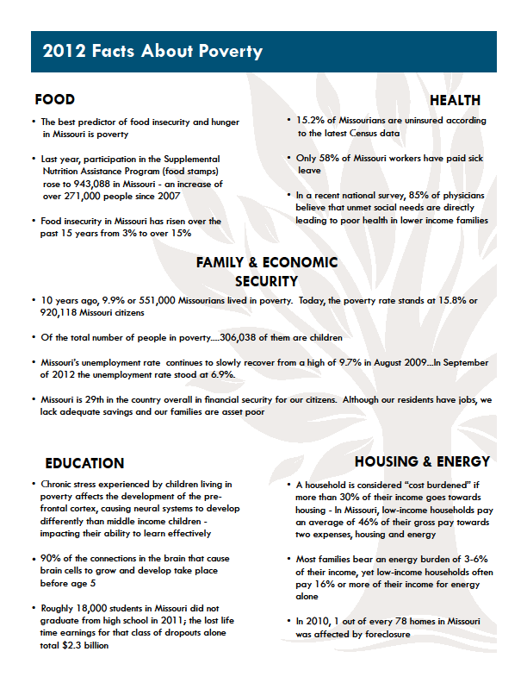
The Missouri Association for Community Action
Research the Issue
Facts & Figures
Resources & Assets
Community Support
Summarize your Research
  Define the Problem
  Define the Solution
  Expected Results
Notes:
You will want to have some facts and figures to support your issues. You need to have credible research, previous evidence, or other’s experiences to discuss.
You also want to research the resources and assets that are available to you. Once you have your goals written down, it is easier to make an inventory of the resources you will need, in terms of organization, money, allies, etc. Resources for advocacy may be very different from those needed to run service programs in your community. You will not necessarily need massive financial support as would be the case if you wanted to create a new community based program. Your list of available resources will vary, according to your issue and your needs but might include some of the following:
Funds (including in-kind contributions) balanced against expenses
People who are already available (both staff and volunteers), and their skills
People you expect to be available
Contacts (e.g., with media resources)
Facilities (e.g., access to transportation and computers, meeting rooms)
Access to information archives or libraries
The simplest way to plan is to write out a list of resources and assets in a binder (or computer file) so you can add new ones as you go along.
When researching your issue, you will also want to create a list of expected allies and opponents. You will want to do some careful planning, including personal contacts and listening. It may be that people you expect to be opponents may also be allies under certain circumstances, and those thought to be allies may oppose your efforts.
Finally, you want to summarize your research around three points:
Defining the problem, defining the solution and the expected results.

Slide 14
Develop a Strategy
4
Notes:
In a sense, advocacy itself is a strategy--it's the way you have decided to reach your particular goal, because you can't get what you want without taking on some institutions and people who have power, and getting that power structure to change.

Slide 15
The Missouri Association for Community Action
Develop a Strategy
Determine Committee
Identify Supporters
State Personnel/Experts
Recruit Advocates
Choosing a Strategic Style
Staying Flexible
Planning Strategies
Notes:
But you will need to develop the specific strategies that will help you reach your goals. As an advocate, you will also have to make sure that your strategies:
Make the best use of your allies and produce the kind of change you want in your opponents
First, you will want to determine which committee by which your legislation and/or cause might be considered. You can find a complete list on the Missouri General Assembly website. You will also want to think of your supporters that you identified in your previous resource list (you may also find additional supporters through this process that you will want to add to the list). You will also want to consider state agency personnel who might be called upon for expert advice.
Finally, you will want to recruit advocates. Start by transferring potential supporters from your previous list and think about who else you know that may support you in your cause. Think of Community members who were or are affected by the issue, businesses who may be affected, churches, civic organizations, etc.
Another point to consider about developing your strategy is that many people assume that because you are involved in advocacy, your strategy will involve confrontation. It may, but that is not always the best approach. Consider different types of confrontation
Less confrontational strategies include: Increasing public awareness through a media campaign, Educating the community, gathering data and working for policy change in local government
More confrontational strategies include
Pickets, boycotts and walkouts.
As you can see, many different actions fit under the definition of "strategy," and they may incorporate many different styles--from friendly persuasion to "in your face." Your choice of style will depend to a great extent on your knowledge of the community, and of what will work (as well as your knowledge of your members and allies, and what they can do best and most comfortably). The point is that you need to think hard about what effect it will have, based on your knowledge of the community, your targets, and the root causes of the issue.
Although it's a good idea to do as much forward planning as possible, an advocacy campaign is likely to be dynamic, adjusting with changing circumstances. Obviously, not everything can be locked in.
It may be useful to brainstorm strategies in the group, and write down those that you feel will help you attain your goals.
Strategies are the broad strokes: they don't spell out specifically how something will get done. That's the job of the tactics (or action steps) that you choose? the next part of the planning process.

Slide 16
Establish a Plan of Action
5
Notes:
The fifth step of the advocacy plan is to establish a plan of action

Slide 17

The Missouri Association for Community Action
Establish a Plan of Action
Clear Message
Supporting Material
Schedule of Legislative Contacts
Develop Tactics/Action Steps
Notes:
The first step in developing a plan of action is to determine a clear message that frames the issue for maximum support. This will allow you to engage your audience. You also want to develop supporting materials: fact sheets, web pages, marketing materials, presentations, etc.
You will also want to develop a schedule for strategic legislative contacts. Again, you can find all of this information on the Missouri General Assembly website.
Finally, you want to develop tactics are the action steps. The finishing touches. The part that shows. Tactics can cover a wide range of activity, from writing letters to speaking up at City Council meetings, from filing complaints to setting up negotiations, from boycotts and demonstrations to carrying out surveys.
As you plan tactics, you will need to make sure that they:
Carry out your strategy, and are appropriate for your goals
Fit your style
Are doable and cost effective
Make your group feel good about themselves, and what they are doing
As you plan tactics, it may be useful to ask yourselves these questions about each of them:
What will be the scope of this action?
Who will carry it out?
When will the action take place, and for how long?
Do we have the resources to make it happen?
What resources are available?
Which allies and constituents should be involved?
Which individuals and organizations might oppose or resist?

Slide 18
Build your Base of Support
6
Notes:
The sixth step is building your base of support. You will want to Utilize the list you created before, you want to build on your base of support.

Slide 19

The Missouri Association for Community Action
Build your Base of Support
Communication
Recruit
Mobilize
Grassroots Efforts
Notes:
After you have determined your list of supporters you will want to determine how you will communicate with your supporters to stay in touch (will you use facebook, twitter, email, or other communication tools). Have a discussion about how often and how you will community with your different audiences: supporters, legislators, general public, etc. Your methods of communication will probably be different based off of your target audience and your relationship with them.
Seek out new supporters and coalitions. Research like organizations and community members that may support your cause.
Most importantly, mobilize your grassroots. Communicate with them and utilize the materials you developed in the previous step.

Slide 20
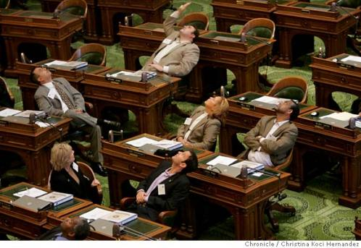
Get to Know People and Key Players
7
Notes:
The seventh step is getting to know people and key players, this step is simple, you want to research who the key players are: supporters and opponents. You have already done some of this work but you will want to highlight who those individuals are that are going to be most involved in the process.
Are there key activities that you can participate in to get more involved and get to know these individuals more? If you do not know some of the key players you will want to identify ways to get to know them.

Slide 21
Know the Process
8

Slide 22
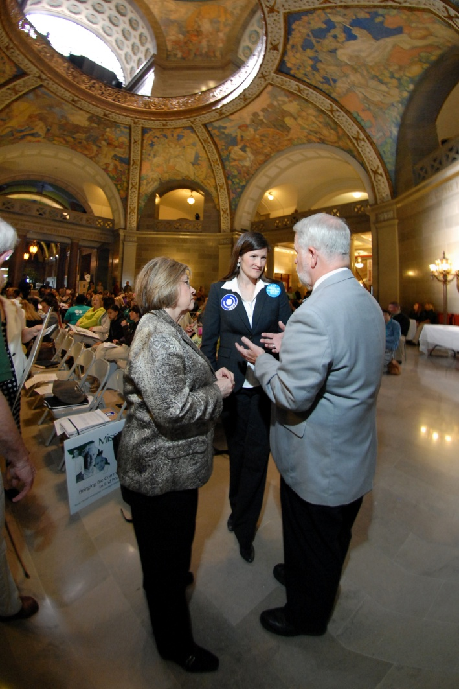
The Missouri Association for Community Action
Know the Process
Get a sponsor
Bill Language
Committees
Other Members
Notes:
You want to know the legislative process. The first step in the legislative process is to 1. Get a sponsor. A sponsor is the person who introduces the bill. Sometimes your education advocacy will cause a policy-maker to decide to write a bill and introduce it. Sometimes (and more likely) as part of your education advocacy, you will have to ask for someone to be the sponsor.
2. Work on bill language on your own. The bill is where it all starts, and it doesn’t have to be long and complex. A bill becomes an act after it is passed and signed by the Governor or President. If you have any doubts about the format for writing a bill, you can ask a legislative aide how it should be done, or use bill tracker search engines to find the text of how other bills are written in the legislative body of your concern.
3. Get to know the committee(s) to which the bill might be assigned.
Who is on the committee?
What is their voting history?
Do you know others who might know the committee members if you don’t?
Although your advocacy work may not come to this, it is important to know the process regardless. There are resources, like a video called school house rock which is a fun and easy way to understand the process.

Slide 23
Monitory Legislative Activity of the Issue
9
Notes:
The final step of the advocacy plan is to monitor legislative activity of the issue. You will want to
1. Prepare for opportunities for public testimony. Frequently, the committee to which the bill is assigned will have a hearing, at which the public is welcome to attend and make comments. This is the time for advocates to make comments regarding their support of the issue, and how considering this issue is so important.
2. You can find out where your bill is in the process, its schedule of meetings and hearings, by following the bill on electronic tracking systems operated by the State of Missouri and U.S. Congress.
3. Have people present to provide testimony.
4. Keep up with your information flow and use your communication mechanisms.
5. Maintain a system and roles. The session isn’t over until it is over, and something that looks “dead” one week can resurrect the next. Keep your system up.
6. Keep realistic expectations.

Slide 24

Developing an Advocacy Plan
Write it Down
Be Tenacious!
The Missouri Association for Community Action
Notes:
The entire plan, covering all nine of the above steps, should be formally written down. The process of writing will help clarify your thinking. The written version will be available to bring us back in line when "scope creep" occurs: we wobble away from our basic plan.
Keep at it! It can take time to create change, especially systems and policy changes.

Slide 25
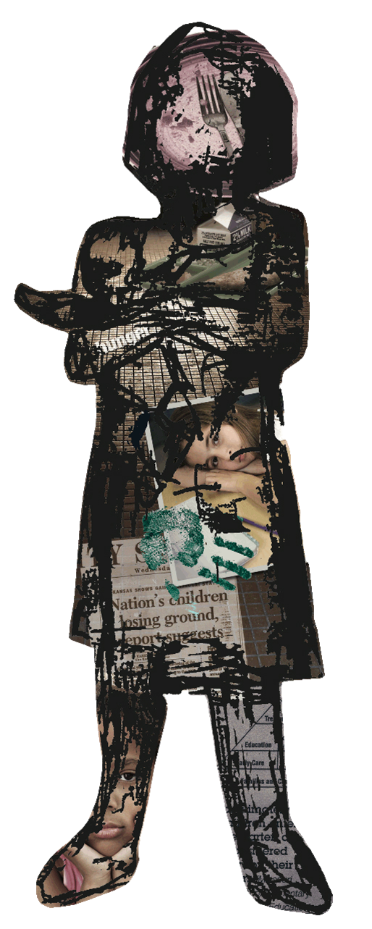

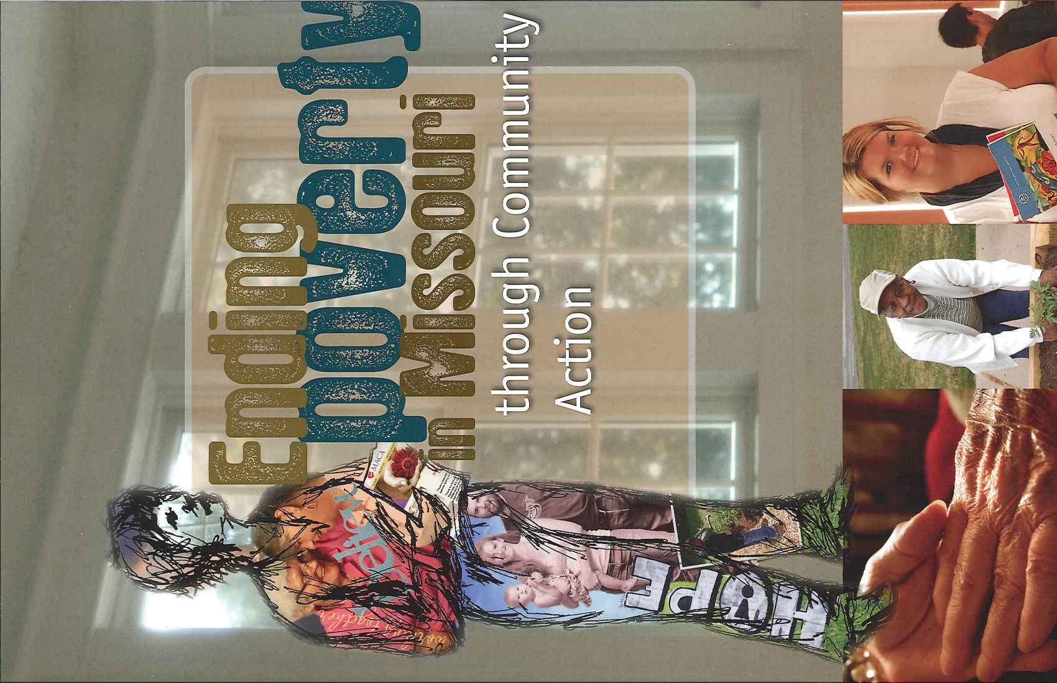
What’s the Difference?
Notes:
Together, we can make a difference and achieve our statewide vision…

Slide 26
Statewide Vision
United in purpose,
the Missouri
Community Action Network
will inspire and engage people
to ensure that all
families and communities thrive.
Notes:
26
Thank you for participating in the developing an advocacy plan webinar. I hope that the information was helpful to you and your advocacy work. I also want to say how much we sincerely appreciate all of the work that you do on behalf of our network and low income people! If there is ever anyway that we can support you please let us know.
These advocacy webinars that we are conducting are new for us and we would love to hear from you what worked well and what was not helpful. I would like to launch three more polls to get your feedback on this webinar.

